Slide 1
Social Studies Interactive Notebook

Slide 2
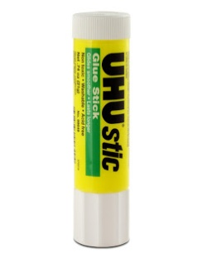
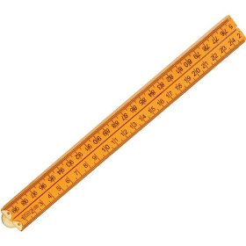
Supplies for Success
Every student will need two 1 subject spiral notebooks this school year.
Other supplies:
Colored pencils
Scissors
Glue sticks
A ruler
*If you need assistance getting supplies please talk to your teacher, guidance counselor, or social worker.

Slide 3
Why do we use Interactive Notebooks?
The purpose of the Interactive Notebook is to engage students in learning while teaching them valuable organizational skills. It is not just about keeping organized though; it is about organizing the learning process.
Students use both their visual and linguistic intelligences.
Notebooks help students to systematically organize as they learn.
Notebooks become a portfolio on individual learning.

Slide 4
Components of Interactive Notebooks
Cover
Data and Goal Tracking Page
Social Studies Class Guidelines
Table of Contents
Paperclip for table of content pages not being used
Post-it Note to use as a bookmark so you don’t waste time looking for the page we left off on.

Slide 5
Procedure 1: Setup and use a Table of Contents
Students must keep the first four pages of their notebook free for a table of contents.
Paperclip these four pages together, and keep them paper-clipped until you use them. This will prevent you from accidentally writing where their next page of contents will eventually go.
You must include the name of the section, the standard it meets, and the pages where they can find the material.
For each page you use after the table of contents, it needs to have a number, a header, and the date it was created. The header should match the title of the section in the table of contents.

Slide 6
Procedure 2: Efficient Cutting Strategies
The amount of time your students spend cutting and pasting should be 1% of the time they are using this notebook to practice or apply.
You will have 5 minutes to cut and glue.
Remember you do not have to cut out each individual section, often cutting the margins will work just fine.
Students who are done early know that the next step is to help someone at their group finish cutting. Here’s an example of what this looks like: Student A finishes in two minutes. Partner B is still working, so he tears off part of the page he is working on and Student A cuts the pieces from that part of the page.
If you aren’t finished when the timer goes off, you need to set your scissors aside and follow the lesson until there is a break for you to finish cutting your pieces.

Slide 7
What do you do with all the trash?
A class helper will take around the recycling bin to pick up all of the pieces.
These helpers also look for scraps on the floor that need to be picked up.
Do not leave trash on or under the desk!
Pick up paper scraps off the floor

Slide 8
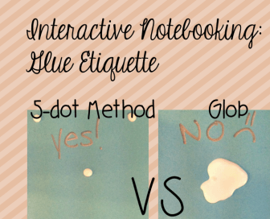
Procedure 3: Glue Use
Don’t over GLUE!
Follow the “5 dot rule”
Put four total dots of glue close to the outer edges to form a rectangle, and one dot of glue in the middle.

Slide 9
Procedure 4: Absent Students
Get any hard copies from teacher
Use the teachers master notebook to copy the assignments you missed.
YOU are responsible for making up the missed activity or assignment.

Slide 10
Procedure 5: Grading
Notebooks show individual learning and should not be copied.
Copied notebooks from other students will be considered cheating and will not receive credit.
Discipline action may be taken for copying and/or taking another students notebook.
Notebooks will be graded at the end of every unit.
Notebooks are worth 25% of your overall average.

Slide 11
Procedure 6: Storage
Notebooks will be kept in the classroom
You may NOT remove notebooks for any reason
At the start of class notebooks will be passed out and collected at the end of class.

Slide 12
Let’s Get Started

Slide 13
Front Cover of Notebook
Name
Core Class
7th Grade Social Studies
Lizards Team
Ms. Woodside
Example:
Sally Smith
Core 4
7th Grade Social Studies
Lizards Team
Ms. Woodside

Slide 14
Back of Front Cover
Data Tracking

Slide 15
Table of Contents
Date | Page | Assignment/Activity

Slide 16
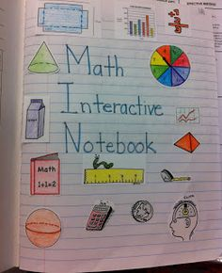
Title Page
Page 1 08/30/2016
Directions- Create a title page for your notebook.
Should include social studies related images
Must be in COLOR

Slide 17
Class Guidelines
Page 2 08/30/2016
Glue handout on this page

Slide 18
Smart Starter Procedures
Page 3 08/30/2016
Glue handout on this page

Slide 19
Week 1 Smart Starters (1-5)
Page 4 08/30/2016
SS #1- None
SS #2- Answer the following questions on your Week 1 Smart Starter page (Page 4)
Where do you turn in homework and classwork?
What percentage is classwork worth towards your final grade?

